Slide 1
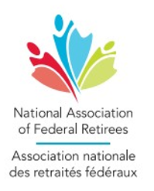
Pilot Project for
Manitoba Branch
Presentation to:
Eastern Manitoba Fall General Meeting
2026 October 13

Slide 2
Expected Benefits of this Pilot Project
Efficiency in operations by reducing to one Branch Executive
Cohesiveness of operations through Communities of Practise
Broaden support to all Manitoba members through local representation
Flexibility for volunteers to provide their talents to specialized areas as needed (e.g. events, communications, recruitment)
Closer tie to National Office through a single point of contact
Notes:
Currently we have four branch executives with 4 Presidents, secretarys, treasurers, etc
With individual teams across the province, we duplicate our effort in all areas (newsletters, planning events, sourcing speakers, etc)
Opportunities for individuals to support different aspects of operations such as events, written communications, etc on as an as needed basis without any formal or long-term commitment

Slide 3
What we heard from you
Manitoba Branches –
Member Priorities Survey
(2026 September )
304 responses which is approximately a 5% response rate

Slide 4
What we heard from you
Which member services do you value most:
Access to Benefits Information 83%
Advocacy on National Issues 78%
Preferred Partner Discounts 55%
Branch Events 37%
Notes:
The top 3 priorities are not tied to your local branch
There is no intention to stop in person events, they will remain available

Slide 5
What we heard from you
What are the branch level activities that are important to you:
80% Information Sessions on federal retiree benefits
62% Wellness or Healthy Aging Programs
52% Guest Speakers (health, finance, government, etc.)
26% Social Events and Member Gatherings
19% Meetings with Local Elected Officials

Slide 6
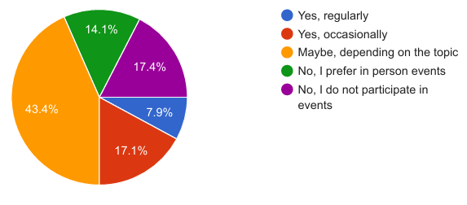
What we heard from you
Would you participate on online events?
68% of you say yes depending on the topic
Notes:
we know in-person events are important to some of our members however there is also an appetite for on-line events
On-line events would allow us to connect with NAFR members outside of the current 4 main centres (Winnipeg, Brandon, Portage and Pinawa)

Slide 7
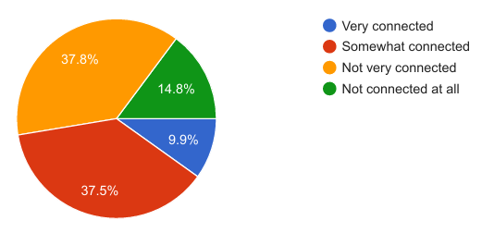
What we heard from you
How connected do you feel to your local branch and fellow members?
Less than 10% of you feel very connected
Less than 50% feel connected to some extent
Notes:
Survey responses, again a low percentage but that is also an indicator, indicate the majority of our members do not feel connected to a local branch
And that’s ok, our members join the association for a variety of reasons
Our job is to ensure we are meeting their needs and supporting the advocacy goals of the Association

Slide 8
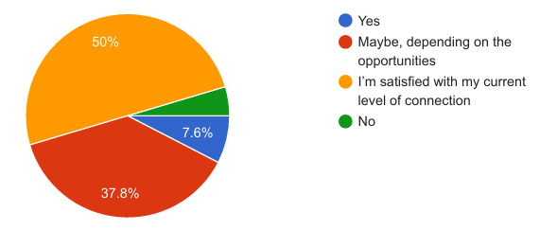
What we heard from you
Would you like to feel more connected to your local branch and fellow members?
50% are satisfied with feeling somewhat or not very connected
Notes:
Again, that’s ok
This isn’t about forcing people to be present at events
We need to support our members where their needs are

Slide 9
What we heard from you
Takeaways:
Members are generally not well connected to their local branch and are comfortable with that
While we do not want to eliminate in-person events, there is an appetite for online events
The most valued member services are not tied to your local branch

Slide 10
Manitoba Branch Proposal
National Board
National Office Paid Staff
Paid staff provide support such as ordering of swag, CRM entries, support with events, fielding phone calls & emails
Manitoba Branch
Manitoba Branch Executive
Manitoba Branch Executive may reside anywhere in the Provice
Communities of Practice
Member Services
Advocacy
Events
Member
Recruitment
Communications
Volunteer
Recruitment
Each Community of Practice consists of a Team Lead and volunteers residing throughout the Province
Notes:
The executive will not reside in any particular location and hopefully will be scattered throughout the province
Our goal is to have individuals supporting the Communities of Practice throughout the province. With this structure, we could have reps in Churchill, Gimli, Steinbach, etc , anywhere where we have members

Slide 11
Next Steps
Establish Communities of Practice
Provide update to Manitoba members
Membership Vote on Pilot Project to amalgamate to one Manitoba Branch
Update job descriptions, bylaws
MB Executive, under Pilot Project, to be formed from the current MB Branches’ executives
Go live

Slide 12


