Slide 1

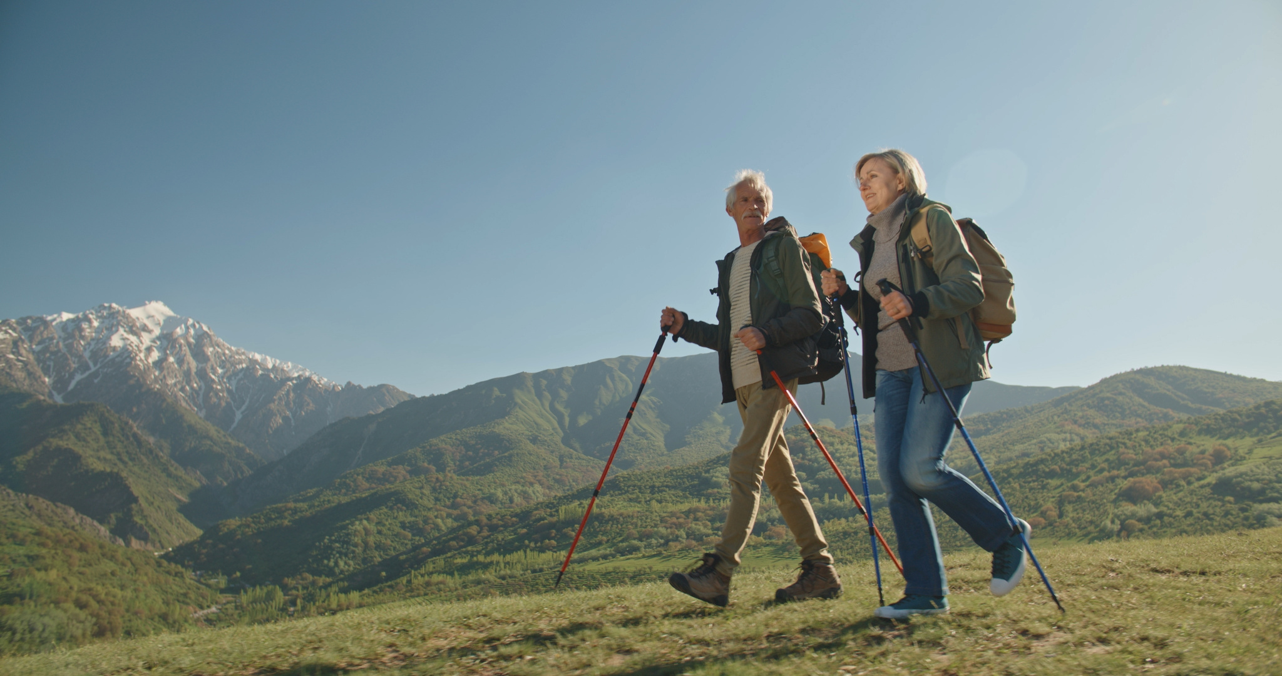
Living with osteoarthritis

Slide 2
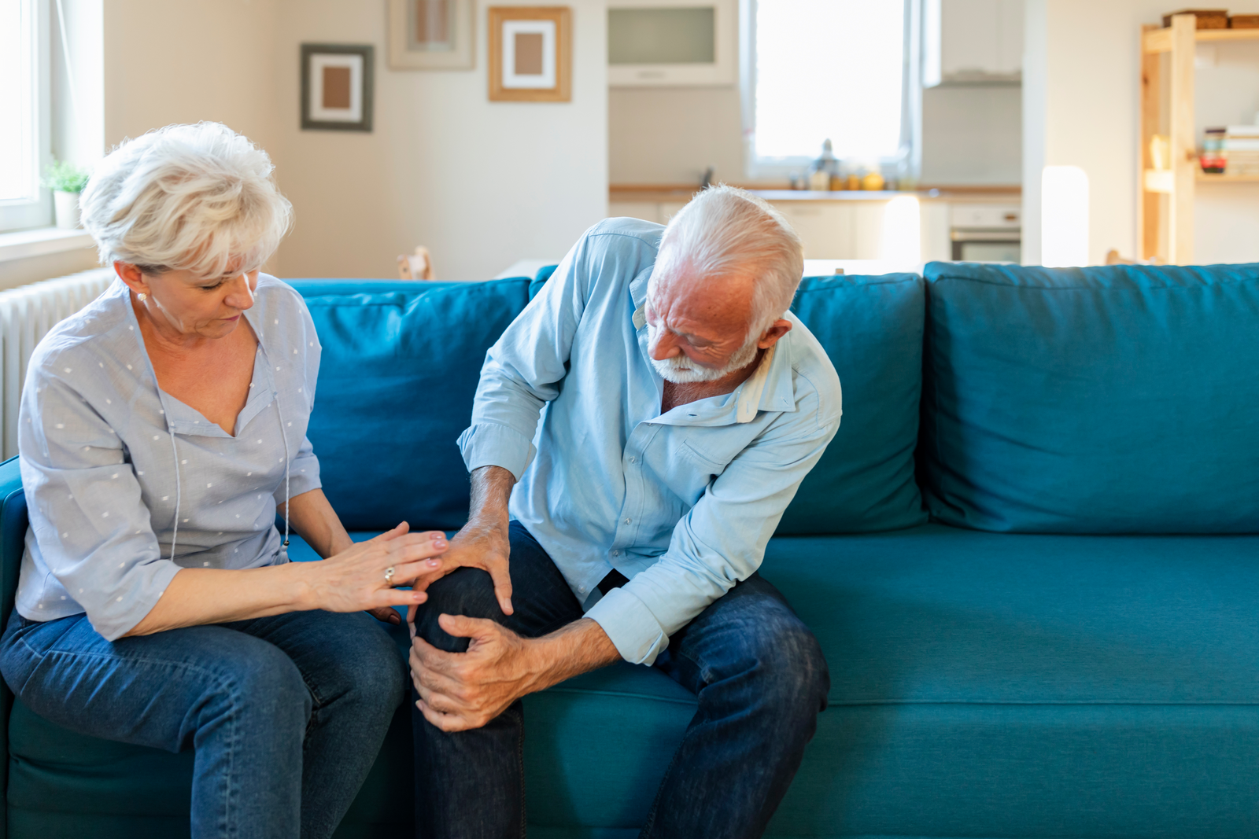

Contents
Who are we?
Why talk about osteoarthritis?
What is osteoarthritis?
Clinical signs
How to relieve pain?
What you can do?
Hip and knee replacement?

Slide 3

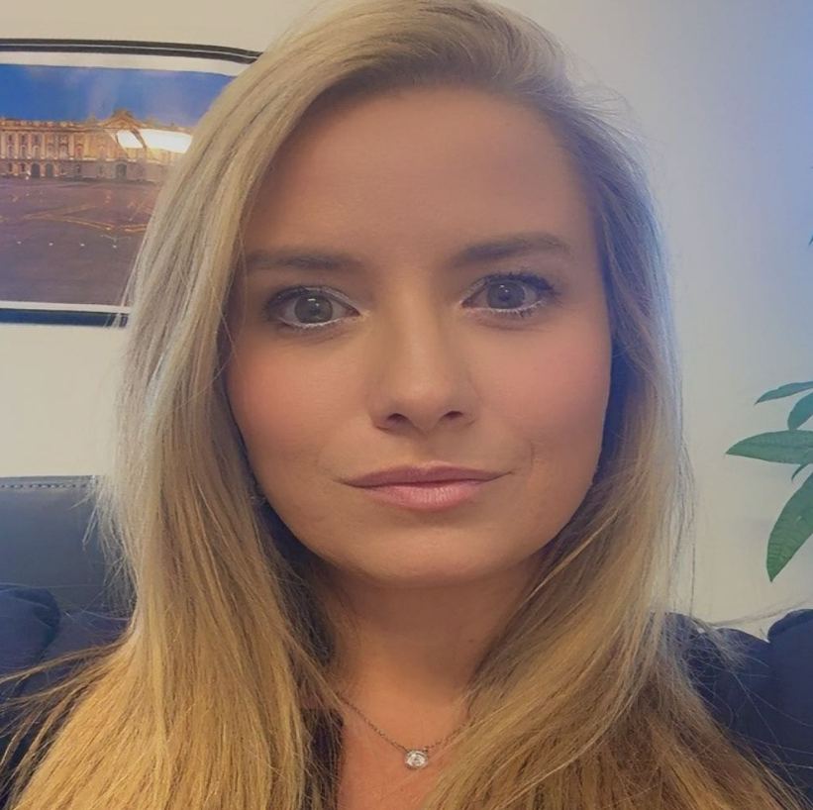
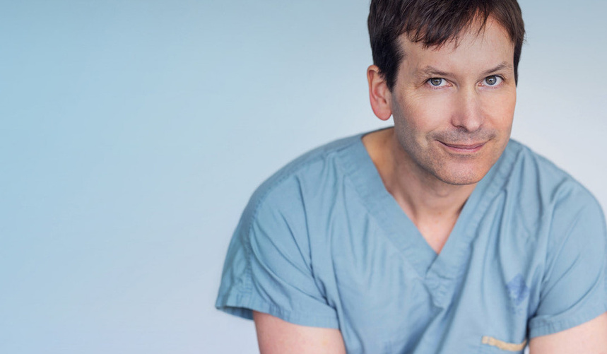
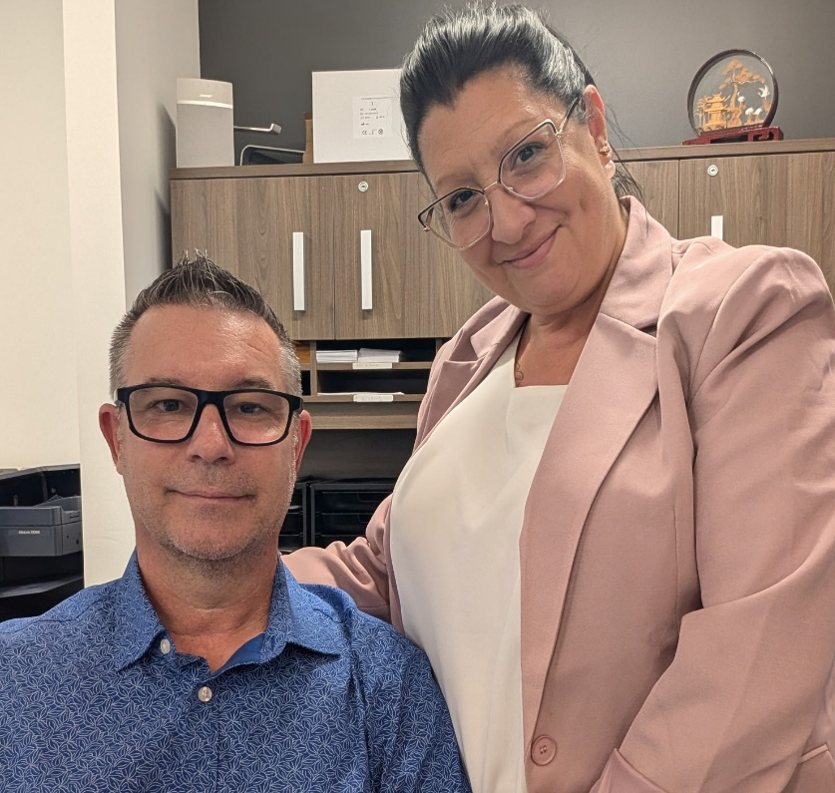
Who we are?
Bérangère Duhen
Dr Benoit Benoit
Karine and Danny
Nurse Coordinator
and
Executive Director
Orthopedic surgeon
Administrative Assistants

Slide 4

Why talk about osteoarthritis?
• Osteoarthritis affects more than one in 7 Canadians.
• It is the leading cause of chronic pain after age 50.
The good news is that there are many solutions to keep moving and live life to the fullest

Slide 5
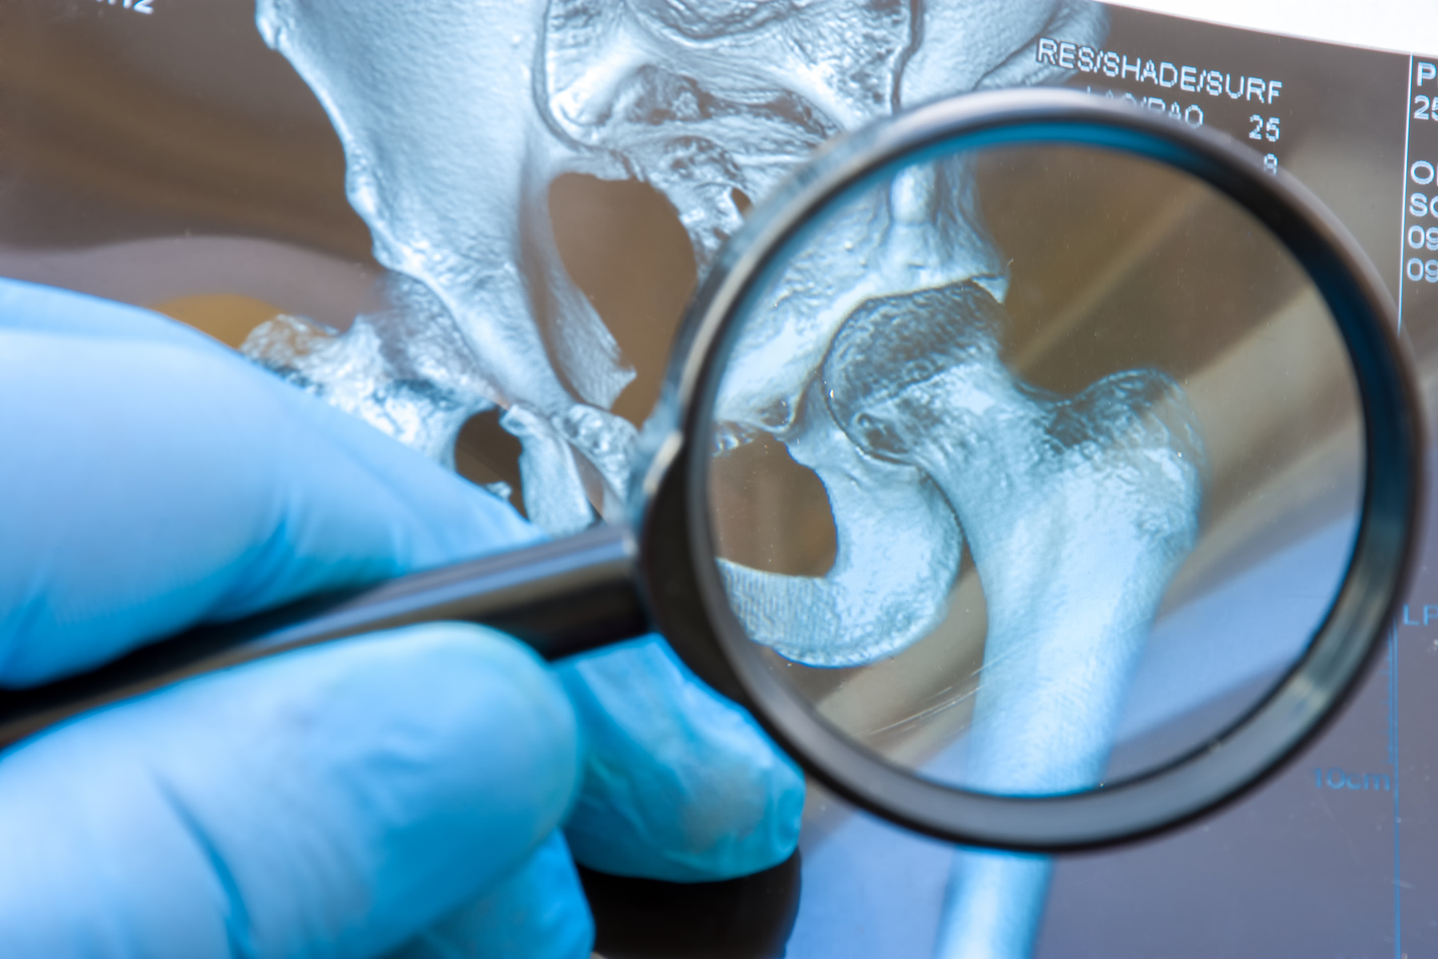

What is osteoarthritis?

Slide 6

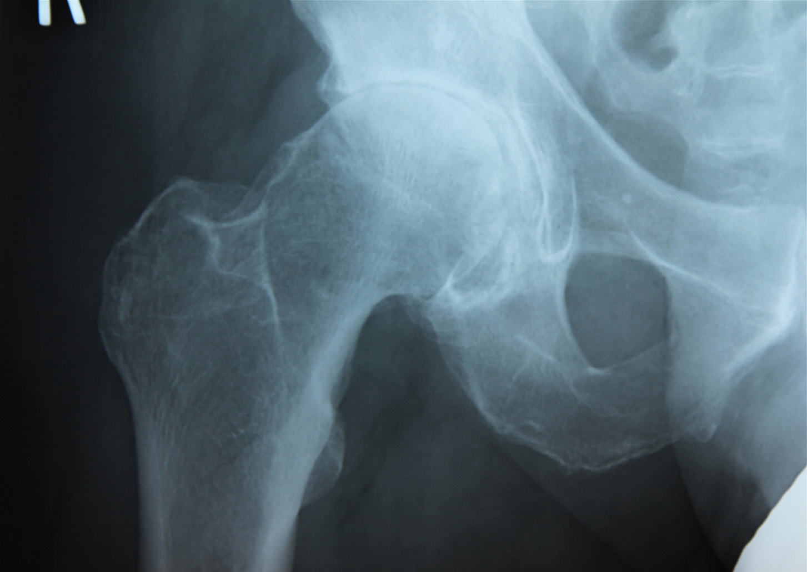
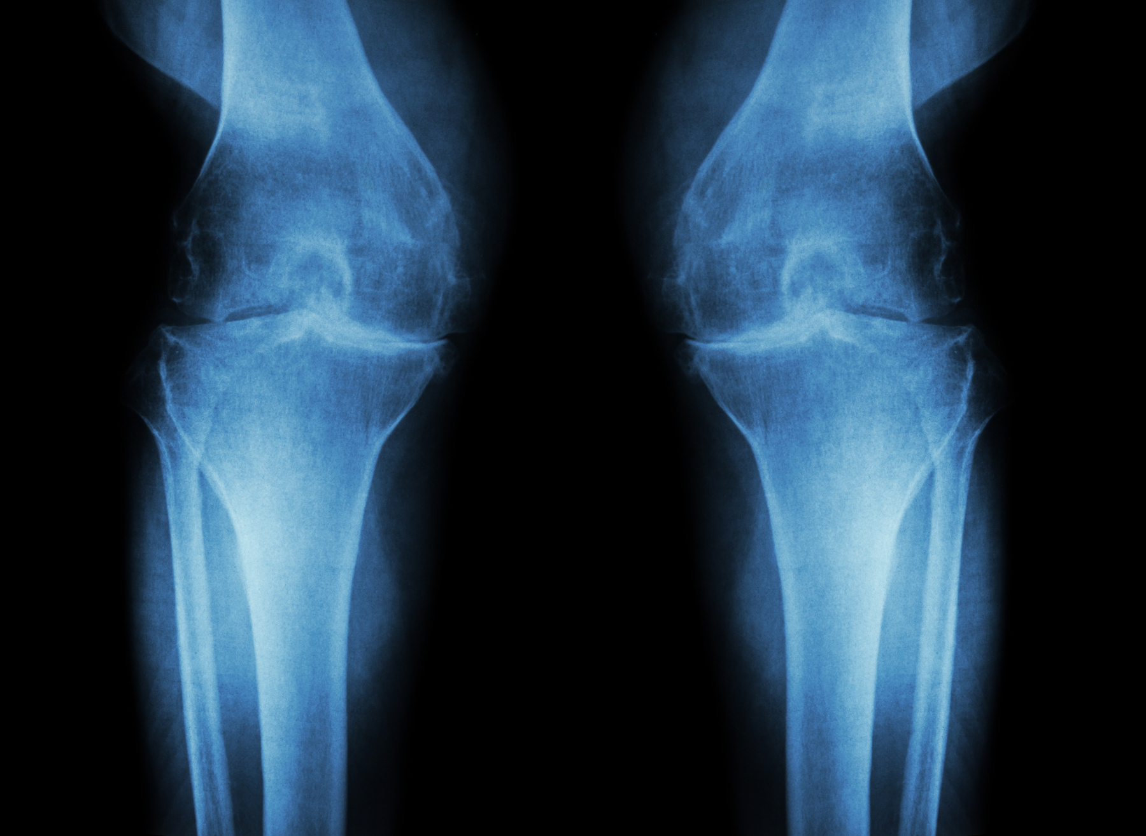
Osteoarthritis
• Progressive wear and tear of the cartilage that covers the ends of the bones.
• Cartilage acts as a shock absorber.
• When it thins, the bones rub → pain and stiffness.
• Affected areas: knees, hips, hands, shoulders, spine.
Risk factors
Age
heredity
Overweight trauma
Repetitive work

Slide 7
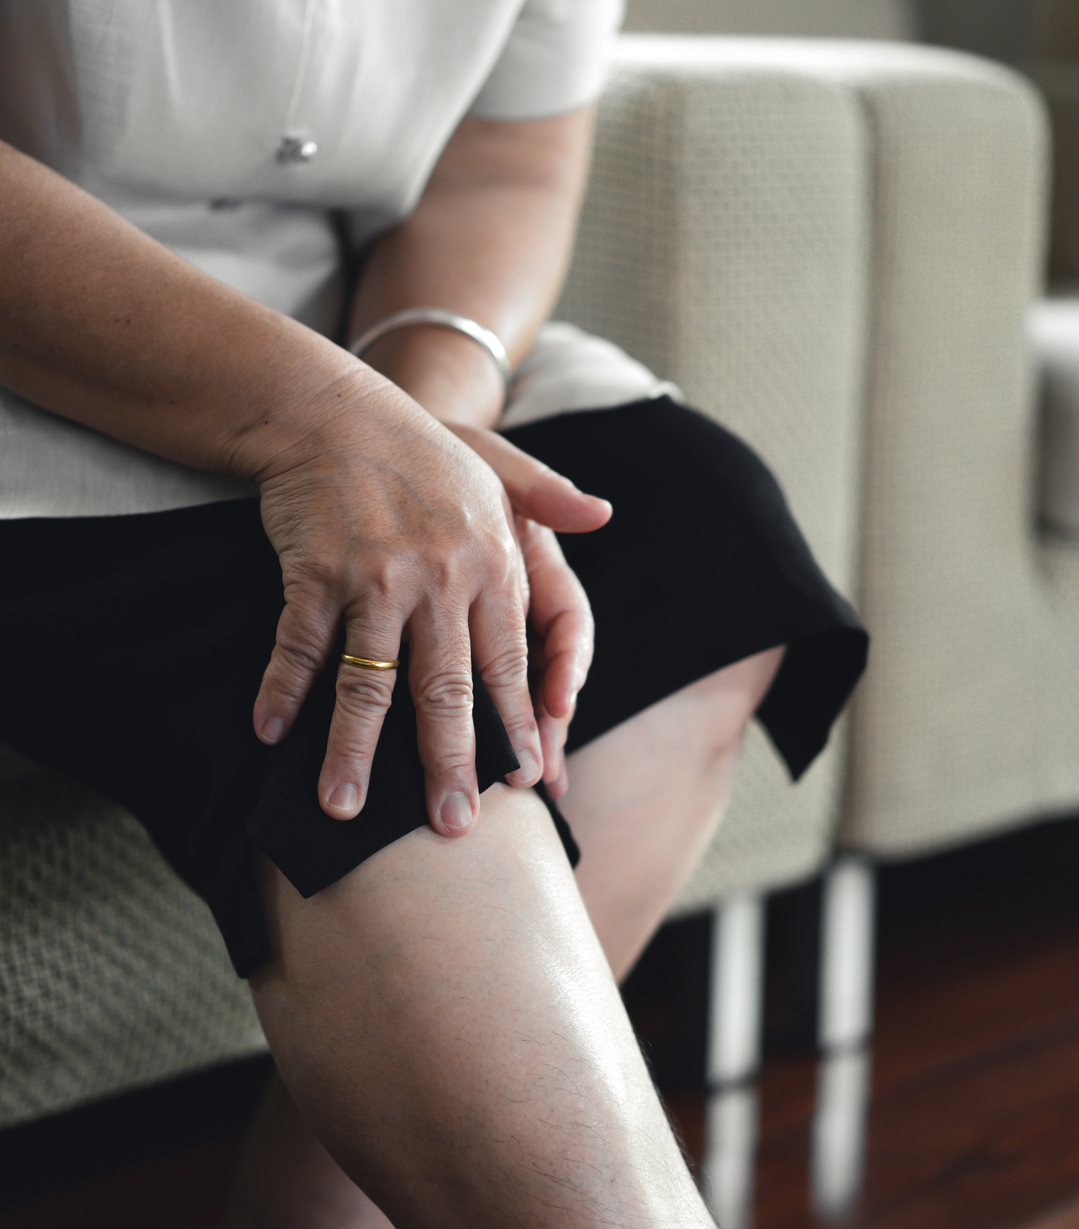

What are the clinical signs?
• Pain on exertion, relieved at rest.
• Morning stiffness (< 30 min).
• Swelling or cracking.
• Loss of mobility, difficulty walking.
• Squeaky sensation.

Slide 8
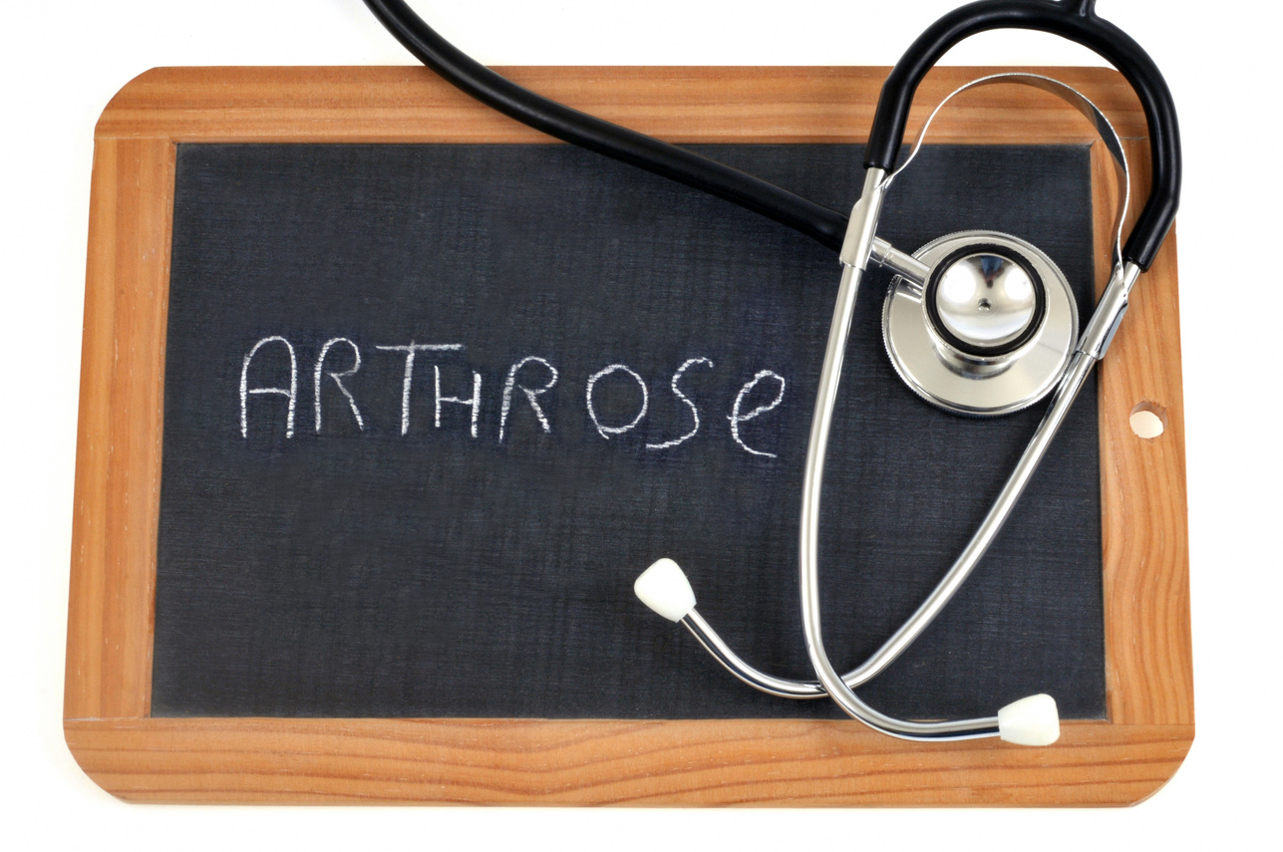
How to relieve pain?
  Cooling
  Painkillers
  Physiotherapy
  Injections
  Surgery
  To be avoided: prolonged rest, total cessation of activity

Slide 9
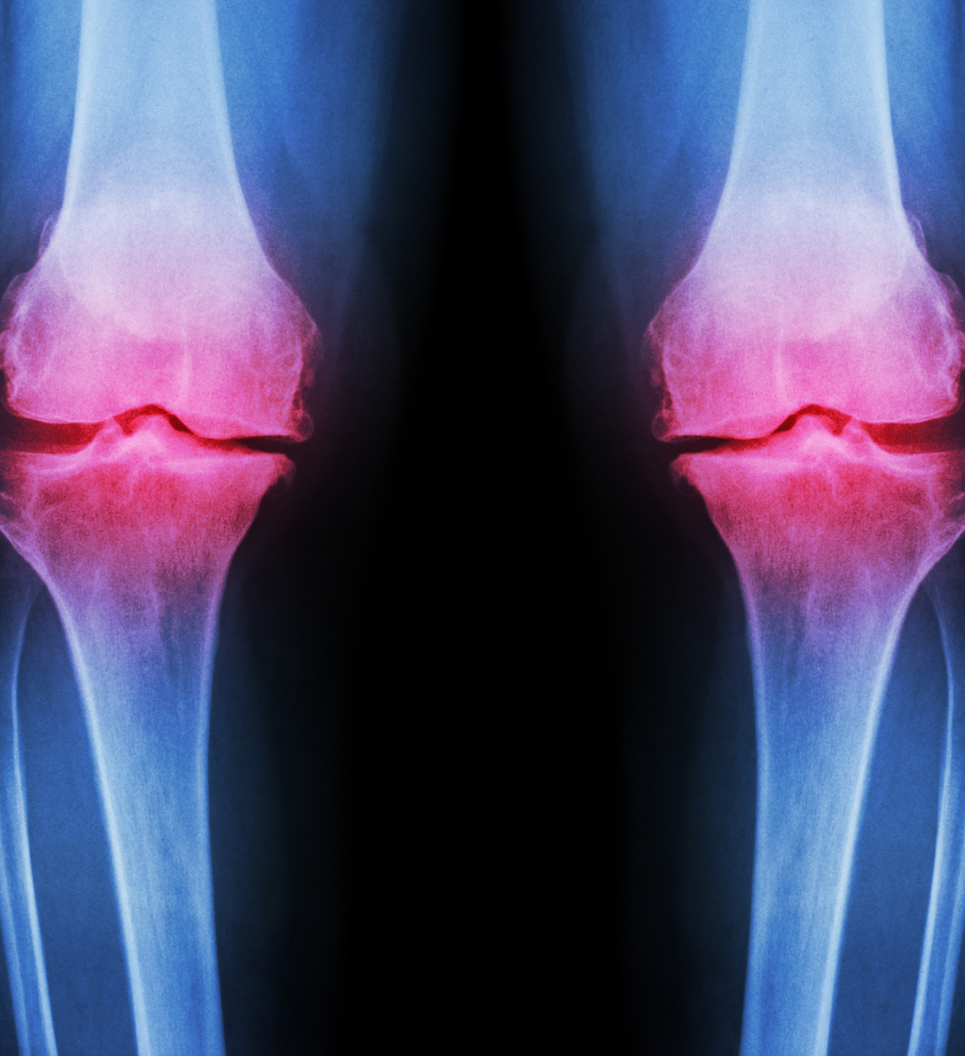
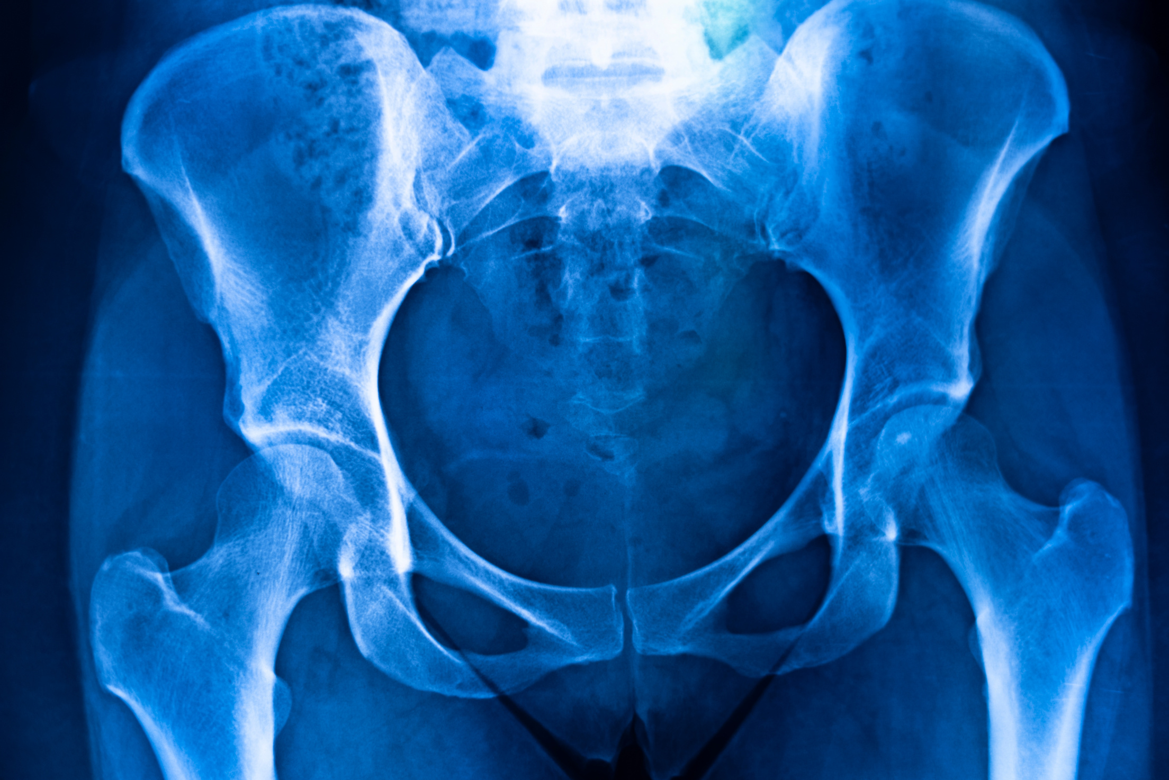

What you can do?
  Consult your doctor
  If the problem is serious, see an orthopedist
  Its role:
      Assess severity.
      Explain the options.
      Supporting the patient in his or her decision

Slide 10

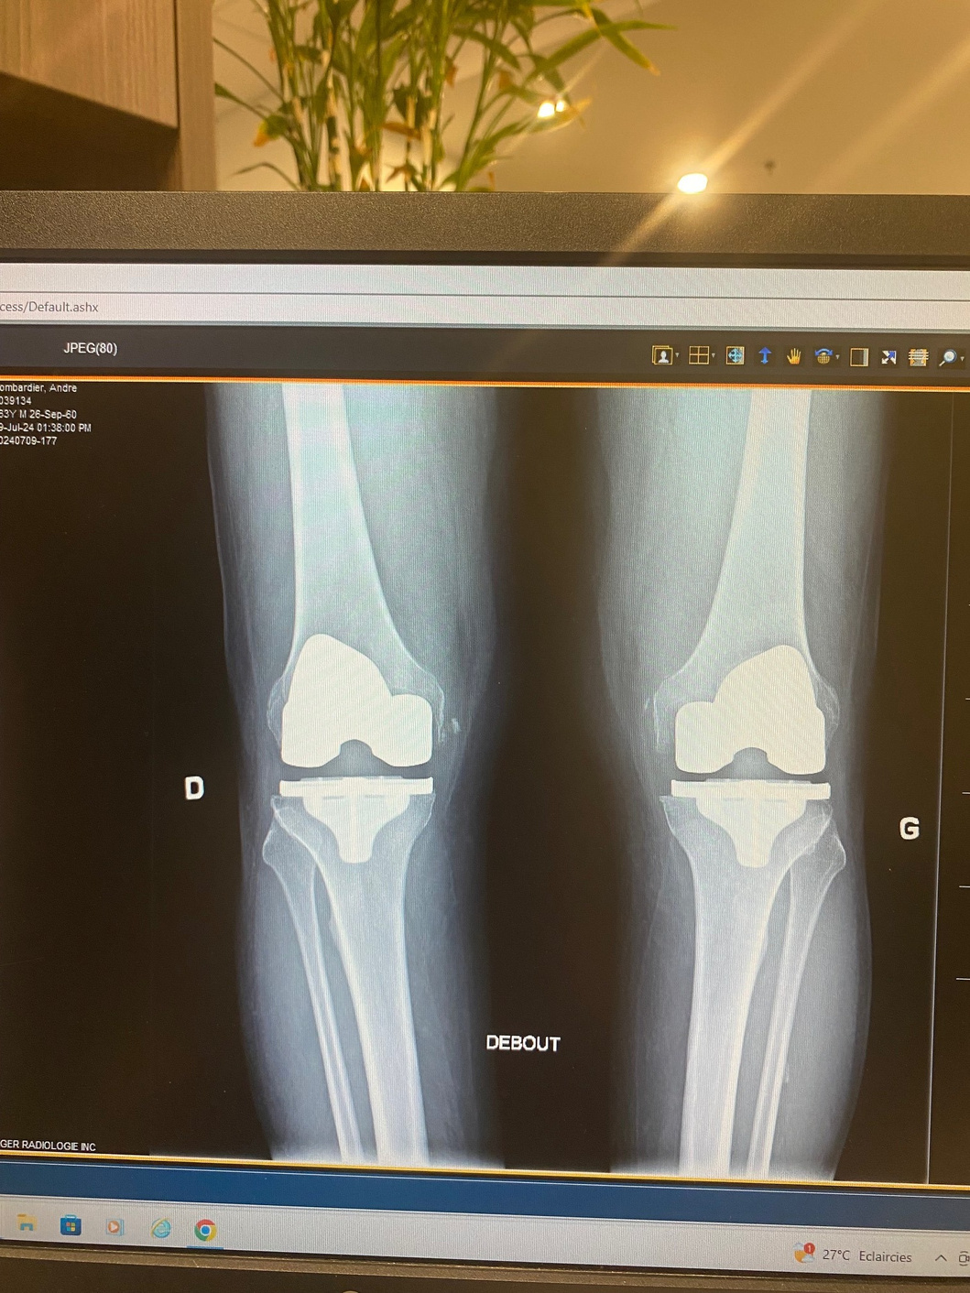
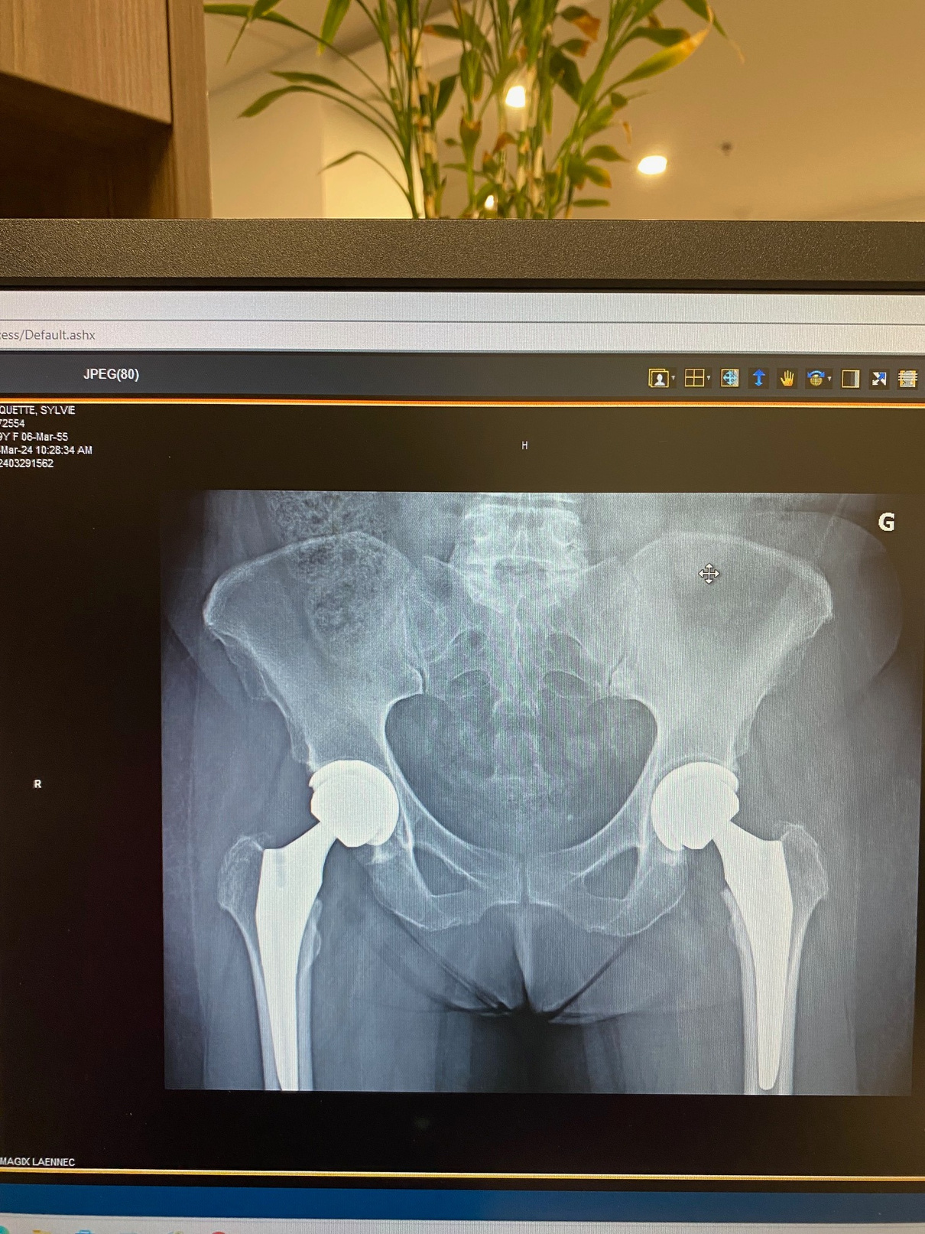
Hip or knee replacement
Knee prosthesis
Hip prosthesis

Slide 11

Hip or knee replacement
Principle: replace the damaged joint with a prosthesis.
Knee prosthesis:
• Relieves pain, corrects the axis, improves walking.
• Lifespan: 20-30 years.
Hip prosthesis:
• Reduces pain, restores mobility.
Lifespan: 20-30 years
• Return to activities: 6 to 12 weeks.

Slide 12

• Preparation: exercises, weight loss, adaptation of the home.
• Short hospitalization: 1 to 2 days.
• Rehabilitation: physiotherapy, assisted walking.
• Results: 90% of patients return to a pain-free active life.
Recovery

Slide 13

Prevention and quality of life
Good reflexes:
• Move every day (walking, cycling, gentle swimming).
• Eat a balanced diet (less sugar, more omega-3).
• Maintain a healthy weight.
• Get enough sleep, manage stress.
“Osteoarthritis is not inevitable. With the right gestures and good follow-up, you can live a long and good life."

Slide 14

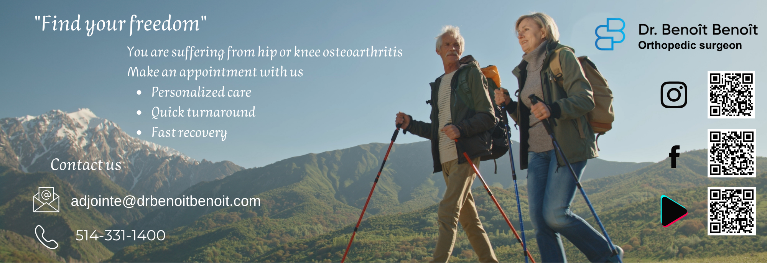
Conclusion
• Understanding your osteoarthritis is already better managing it.
• Many solutions exist before surgery.
• And when it's needed, the results are excellent.

Slide 15
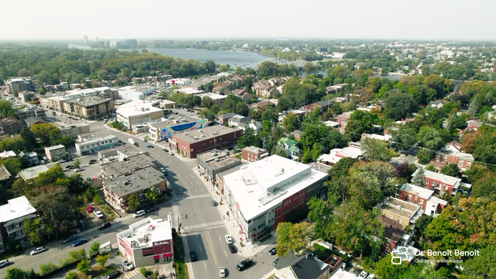
Contact us
drbenoitbenoit.com
adjointe@drbenoitbenoit.com
514-331-1400
5777 Gouin Boulevard West
Montreal, Quebec H4J 1E3

