Slide 1
Annual General Meeting of the Ottawa Valley Branch
May 5, 2027

Slide 2
WELCOME
National Association of Federal Retirees Annual General Meeting will get started momentarily.
Please help yourself to a refreshment as you wait.
Please find a seat.
Thank You

Slide 3
Welcome
Introductions
Interim President – Ian Bennett
Interim Vice President – Paul Langham
Interim Treasurer – Mike Hawkes
Interim Director – Pat Davies
Lionel Raymond – Governance Officer, NAFR, National Office
Aaron Wise – Corporate Services Officer, NAFR, National Office

Slide 4
Agenda – Part One
Information Session
1:00 | Welcome, Introductions and Administration | Ian Bennett
1:10 | Compassionate Ottawa – Advanced Care Planning | Jack McCarthy, Vice-Chair Compassionate Ottawa
1:35 | Mobilizing Retirees Through Volunteering and Events. Opportunities For Partnership | Steven Chapman, President Ottawa Branch, NARF
2:00 | Health Break – Light Refreshments Served

Slide 5
Agenda – Part Two
Ottawa Valley Branch Business Meeting
2:10 | Call to Order & Confirmation of Quorum | Ian Bennett
2:15 | Approval of Agenda Including Consent Agenda | Ian Bennett/Members
2:16 | Overview – Branch Activities and Priorities | Ian Bennett
2:25 | Financial Update | Mike Hawkes
2:35 | Consideration/Approval of By-Law Changes | Ian Bennett/ Members
2:45 | Call For Nominations/Confirmation of Directors | Ian Bennett/ Members
2:55 | Next Steps/Wrap-Up | Ian Bennett
3:00 | Adjournment | Ian Bennett/ Members

Slide 6
Compassionate Ottawa – Advanced Care Planning
Presented by: Jack McCarthy, Vice-Chair Compassionate Ottawa
For further information, questions or follow-up please feel free to contact us:
Compassionateottawa.ca
613-232-4026
info@compassionateottawa.ca

Slide 7
Mobilizing Retirees Through Volunteering and Events
Opportunities For Partnership
Presented by: Steven Chapman, President Ottawa Branch, NARF

Slide 8
Health Break
You have 10 minutes
Please help yourself to the refreshments provided.
Please ensure that you are back in your seats no later than 2:10 so that we can continue with the meeting agenda.
Thank you

Slide 9
Detailed Business Meeting Agenda
Ottawa Valley Branch Business Meeting
2:10 | Call to Order – Explanation of Governing By-Laws and Voting Process. Confirmation of Quorum | Ian Bennett
2:15 | Approval of Agenda Including Consent Agenda (motion to approve, including Minutes of previous AGMs) | Ian Bennett/ Members
2:16 | Overview – Branch Activities and Priorities (Report as being received) | Ian Bennett
2:25 | Financial Update (Report as being received) | Mike Hawkes
2:35 | Consideration/Approval of By-Law Changes (Motion to Approve) | Ian Bennett/ Members
2:45 | Call For Nominations/Confirmation of Directors (Motion to Approve) | Ian Bennett/ Members
2:55 | Next Steps/Wrap-Up (Information) | Ian Bennett
3:00 | Adjournment (Motion to Adjourn) | Ian Bennett/ Members

Slide 10
President’s Report Ottawa Valley Branch of the National Association of Federal Retirees
Ian Bennett,
Interim President
May 2025

Slide 11
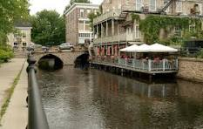
Outline
Why an active, sustainable Ottawa Valley Branch is important
Context – Branch challenges 2023 - 2024
Status – priorities and objectives of Interim Board
Positioning the Branch for success
Charting the future of the Ottawa Valley Branch
Going forward
Page 2

Slide 12
Why Local Branches are Important
Background
Ottawa Valley Branch represents some 1,700 federal retirees and their families throughout the Ottawa Valley
Respective roles and objectives for Association, Branches and National Office well articulated in the NAFR Strategic Plan
Why the Ottawa Valley Branch is important
Member engagement – local interests and concerns - Understand and take forward interests to the National Office and local decision-makers
Communication – informing members of initiatives and opportunities that affect them highlighting local aspects
Support – through volunteer engagement and member mobilization, support local communities and the NAFR
Opportunity
Outstanding support from the National Office
Partnership/collaboration with Ottawa, Gatineau and Cornall Branches
Foundation for success – Interim Board
Page 3

Slide 13
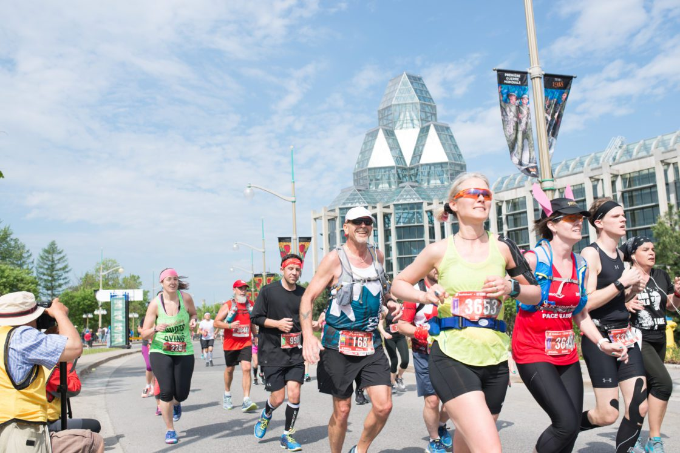
Context – Branch Challenges
Unable to conduct operations and normal Branch functions from October 2023 – January 2025 per Branch and National By-laws
Resignation of previous Board
Unable to hold AGM in 2024 - lack of a quorum despite two attempts
Absence of volunteers – require four Directors to constitute Branch Board
Administrative suspension – Branch financial and administrative functions managed by National Office
Branch membership fees retained in ear-marked reserve
Impact – foregone opportunities and obligations -
Voice not heard – key events – elections, National Association strategic and organizational reviews
Partnerships and information sharing
Page 4

Slide 14
Objectives and Priorities – Interim Board
January 2025 – New Branch Board constituted through recruitment/appointment of four Directors (Bennett, Langham, Hawkes, Davies)
Regular Board meetings, engagement with National Office, other Branches
Objective
Incrementally stabilize and strengthen the Branch through member engagement and mobilization
Priorities
Successful AGM with quorum of members
Attract members to serve as Directors and transition Board and Branch to full, regular functions
Strategies – positioning the Branch for success
Governance changes – quorum and Director nomination procedures
Financial management and resources
Active communications – mail-outs and website
AGM agenda – guest speakers to spark interest
Support – National Office noting Board decision to leave Branch under Administrative Suspension pending successful AGM and new Board
Page 5

Slide 15
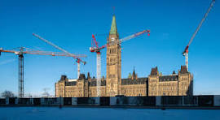
Building Our Future
Two essential conditions for sustainable Branch functions in 2025 and beyond
Successful AGM – participation and quorum of 1% of membership
Recruitment of new Directors – all Board/Executive positions
Depending on outcome of the AGM, current Board will consider all options
Scenario 1 – Branch moves forward
Determine personal interest and willingness to continue to serve
Welcome and support transition to new Board
Scenario 2 – strategic review of Branch
In consultation with National Office and members, consider long-term viability and sustainability of Branch
Page 6

Slide 16
Next Steps
Confirm new Board/Executive roles and support transition
Report to National Office on AGM/Branch affairs (per national by-laws for all Branches)
At discretion of new Board
Assume normal financial and administrative operations – set aside Administrative Suspension
Continue to strength communication, member engagement, outreach
Strengthen partnerships – Ottawa and district Branches, community groups
Page 7

Slide 17
Thank you and Q+As

Slide 18
Financial Update
Ottawa Valley Branch Financial Statement – 2024 Earnings/Loss
 | Actual - 2023 | Actual - 2024
Revenue
Fees - Adjustments | $256.57 | -$12.24
Fees – National (incl. per capita & CC fees) | $12,988.83 | $13,821.76
 | $12,732.26 | $13,809.52
Expenses
Branch AGM (excludes food & bev.) | $324.60 | $698.93
Branch Financial Management | $160.00
Branch Information Sharing Event (excludes food & Bev..) |  | $56.30
Branch Recruitment Event (includes food & bev.) | $342.55 | $764.84
Branch Recruitment Event (includes food & bev.) | $342.55 | $764.84
Branch Volunteer Support & Engagement | $225.99
Community Activities / Events | -$100.00
Equipment & Depreciation Expense | $406.79 | $1,401.96
Phone / Internet | $434.98
Operating Expenses | $1794.91 | $2,922.03
Miscellaneous (non-operating) | $13,488.00 | $11,222.36
Non-Operating Expenses | $13,488.00 | $11,222.36
Total Expenses | $15,282.91 | $14,144.39
Earnings (Loss) | -$2,550.65 | -$334.87

Slide 19
Ottawa Valley Branch Financial Statement – Balances – Year 2024
 | Actual - 2023 | Actual - 2024
Assets
Chequing | $0.00 | $0.00
Savings | $0.00 | $0.00
Computer & Equipment | $1,401.96 | $0.00
Investments | $0.00 | $0.00
Other | $8,369.93 | $0.00
At National | $21,925.06 | $31,439.19
 | $31,696.95 | $31,439.19
Liabilities
Accounts Payable | $0.00 | $0.00
Future Year Fees | $1,763.56 | $1,840.67
 | $1,763.56 | $1,840.67
Net Assets | $29,933.39 | $29,598.52
Reserved
Equity – Defense of Benefits (National) | $3,000.00 | $3,000.00
Equity – Other | $0.00 | $0.00
Equity – Rental Facilities | $4,000.00 | $4,000.00
Equity – Special Events | $3000.00 | $3,000.00
Equity – Training/Succession Planning | $2,000.00 | $2,000.00
 | $12,000.00 | $12,000.00
Unreserved
Unreserved Equity | $20,484.04 | $17,933.39
Earnings (Loss) | -$2,550.65 | $-334.87
 | $17,933.39 | $17,598.52
Total Equity | $29,933.39 | $29,598.52
Notes:
Financial Update continued.

Slide 20
Financial Update
Ottawa Valley Branch Financial Statement – Balances – Year 2024
 | Actual - 2023 | Actual - 2024
Assets
Chequing | $0.00 | $0.00
Savings | $0.00 | $0.00
Computer & Equipment | $1,401.96 | $0.00
Investments | $0.00 | $0.00
Other | $8,369.93 | $0.00
At National | $21,925.06 | $31,439.19
 | $31,696.95 | $31,439.19
Liabilities
Accounts Payable | $0.00 | $0.00
Future Year Fees | $1,763.56 | $1,840.67
 | $1,763.56 | $1,840.67
Net Assets | $29,933.39 | $29,598.52
Reserved
Equity – Defense of Benefits (National) | $3,000.00 | $3,000.00
Equity – Other | $0.00 | $0.00
Equity – Rental Facilities | $4,000.00 | $4,000.00
Equity – Special Events | $3000.00 | $3,000.00
Equity – Training/Succession Planning | $2,000.00 | $2,000.00
 | $12,000.00 | $12,000.00
Unreserved
Unreserved Equity | $20,484.04 | $17,933.39
Earnings (Loss) | -$2,550.65 | $-334.87
 | $17,933.39 | $17,598.52
Total Equity | $29,933.39 | $29,598.52

Slide 21
Motions to Consider and Approve Changes to the Branch By-Laws
Proposed Change to Definition of Quorum “In accordance with section 10.2 of the ON53 by-laws, that section 8.5 of the ON53 by laws (Quorum) be amended from: “At any Branch Annual, Special or General meeting, the quorum required to conduct business is 2% of the membership at the time of the meeting.” to: “At any Branch Annual, Special or General meeting, the quorum required to conduct business is 1% of the membership at the time of the meeting, but never less than two times the number of directors currently in office plus one.”
Proposed Change to Date of Branch Annual General Meeting “In accordance with section 10.2 of the ON53 by-laws, that section 8.1.1 of the ON53 by-laws be amended from: “The Branch executive shall determine the date, location, and agenda of the meeting. The date shall be no later than April 15th.” to: “The Branch executive shall determine the date, location, and agenda of the meeting. The date shall be no later than May 15th.”
Proposed Change – Acceptance of Nominations from the Floor “In accordance with section 10.2 of the ON53 by-laws, that section 5.6.1 of the ON53 by-laws (Nominations from the floor or by the membership) be amended from: “Additional nominations from the floor at the Branch Annual General Meeting are not permitted. Members may nominate any member by submitting the nomination in writing to the Chair of the Nominating Committee, or to the Branch President, no later than 15 days prior to the Branch Annual General Meeting. The nomination must be supported by a written statement from the nominee indicating the nominee’s willingness to serve.” to: “Branch members may make additional nominations from the floor at the Branch Annual Meeting. If a member is absent when nominated, the nomination must be supported by a written statement from the nominee indicating the nominee’s willingness to serve.”
Notes:
A notice of the proposed changes to the Branch By-Laws was provided to members by email on March 20, 2025. This notice advised of the following: At meetings of the Ottawa Valley Branch Executive (January 28, 2025 and February 18, 2025) and in accordance with 10.2 of the Ottawa Valley Branch by-laws, the Executive approved the following proposed changes to the Branch by-laws subject to approval of members via a vote at the Branch AGM.

Slide 22
Motions to Consider and Approve Changes to the Branch By-Laws
Proposal is that the Branch members consider and approve these amendments collectively as an omnibus revision to our By-Laws unless there is a request to consider each proposed amendment separately
Questions or clarifications??
Discussion??
Call for a motion to approve.

Slide 23
Call for Nominations
Article 5.1.1 of the Branch By-laws states that: “the Branch executive shall comprise of four to 10 directors. Of these directors, four must serve as the following officers: President, Vice-President, Secretary and Treasurer. The directors shall all be elected by the members, and these officers shall be appointed by the Branch executive from among the elected directors.”
Therefore, the call for nominations is for volunteers to lead the Branch as Directors and this pool of interested and committed individuals will act as the Branch executive leadership This duly elected executive team will then select the Officers of the Branch including President, Vice-President, Secretary, Treasurer as well as Directors at Large.
In accordance with the Branch and National By-Laws, there must be a minimum of four Directors and formally designated Officers for the Branch to operate. Appointment is typically for a two-year period
In order to facilitate the recruitment of Directors, we have amended the By-Laws to allow for nominations from the floor.
I am pleased to report and thank Kathy Hoyland, a member of our Branch that has come forward and offered to serve as a Director.
Questions??
Notes:
I will now call for expressions of interests to serve as Directors of our Branch. If individuals could raise their hands, stand and introduce themselves we will proceed.
We will note all expressions of interests and formally table the appointment of these persons as a motion to appoint the collective group of Directors unless there is a request to consider each nominee individually.

Slide 24
Member Vote on Nominations
Branch By-Laws stipulate that if there are less than ten (10) candidates for Director positions, they may be acclaimed (rather than voted individually)
Motion: “That the following members be acclaimed as Directors of the Ottawa Valley Branch of the NAFR in accordance with the Branch and Association by-laws”
Nominees are:
Kathy Hoyland
Other
Other
Other
Notes:
I will now call for expressions of interests to serve as Directors of our Branch. If individuals could raise their hands, stand and introduce themselves we will proceed.
We will note all expressions of interests and formally table the appointment of these persons as a motion to appoint the collective group of Directors unless there is a request to consider each nominee individually.

Slide 25
Next Steps
Actions arising from this AGM and helping the Branch move forward – what is next?
Word of special thanks to interim Directors and National Office for tremendous support

Slide 26
Adjournment
Thank You For Your Support

