Slide 1
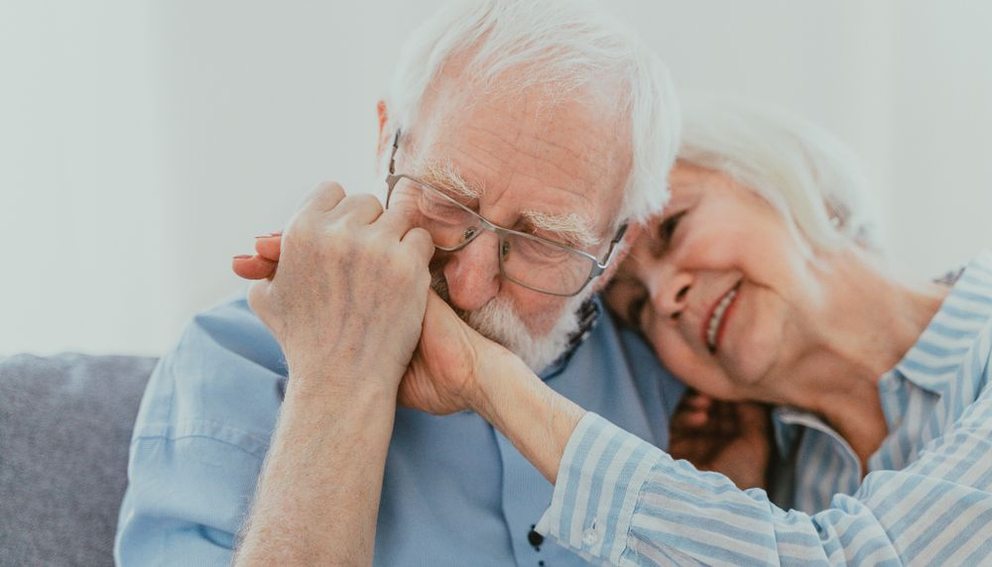
Sexuality does not retire!
Lorraine Séguin
Relationship Therapist
Relationship coach for couple and dyad
Professional Coach

Slide 2
Introduction
Sexuality changes when we advance in age, but it doesn't retire!
We believe that it is retiring because the society has set the age of 65 as the age of retirement, therefore we believe it's the same for sexuality. But the age considered as the beginning of old age is based on history, not biology.
In reality, some seniors prefer abstinence, at the same time there are some quite happy even after 60. Statistics show that many people around the age of 70 still engage in regular sexual activity:
        54 % of men
        31 % of women
Notes:
Why some are still active? Probably they had a strong sexuality before or they changed the way they look at sexuality by having a better understanding that it is a fondamental need.

Slide 3
Objectives
The objectives are to:
Define what is sexuality
Bring the false beliefs related to seniors’ sexuality
Identify the changes and their impact on sexuality
  Changes to an aging body
  Body image and attractiveness
Propose ways to experience greater satisfaction in your sexuality

Slide 4
Beliefs around the seniors’ sexuality
Some beliefs about the seniors’ sexuality are:
  Sexuality belongs to youth
  That older people don't make love anymore or have no sexual desires
Notes:
Those beliefs limits us to take care of our sexuality and we can settle for less than we would like.
Beaucoup croit que la sexualité appartient aux jeunes et qu’en vieillissant notre sexualité n’existe plus.
Le désir change souvent dû au changement de regard sur notre corps, les préoccupations, et quand il y a moins de connexion cœur à cœur.

Slide 5
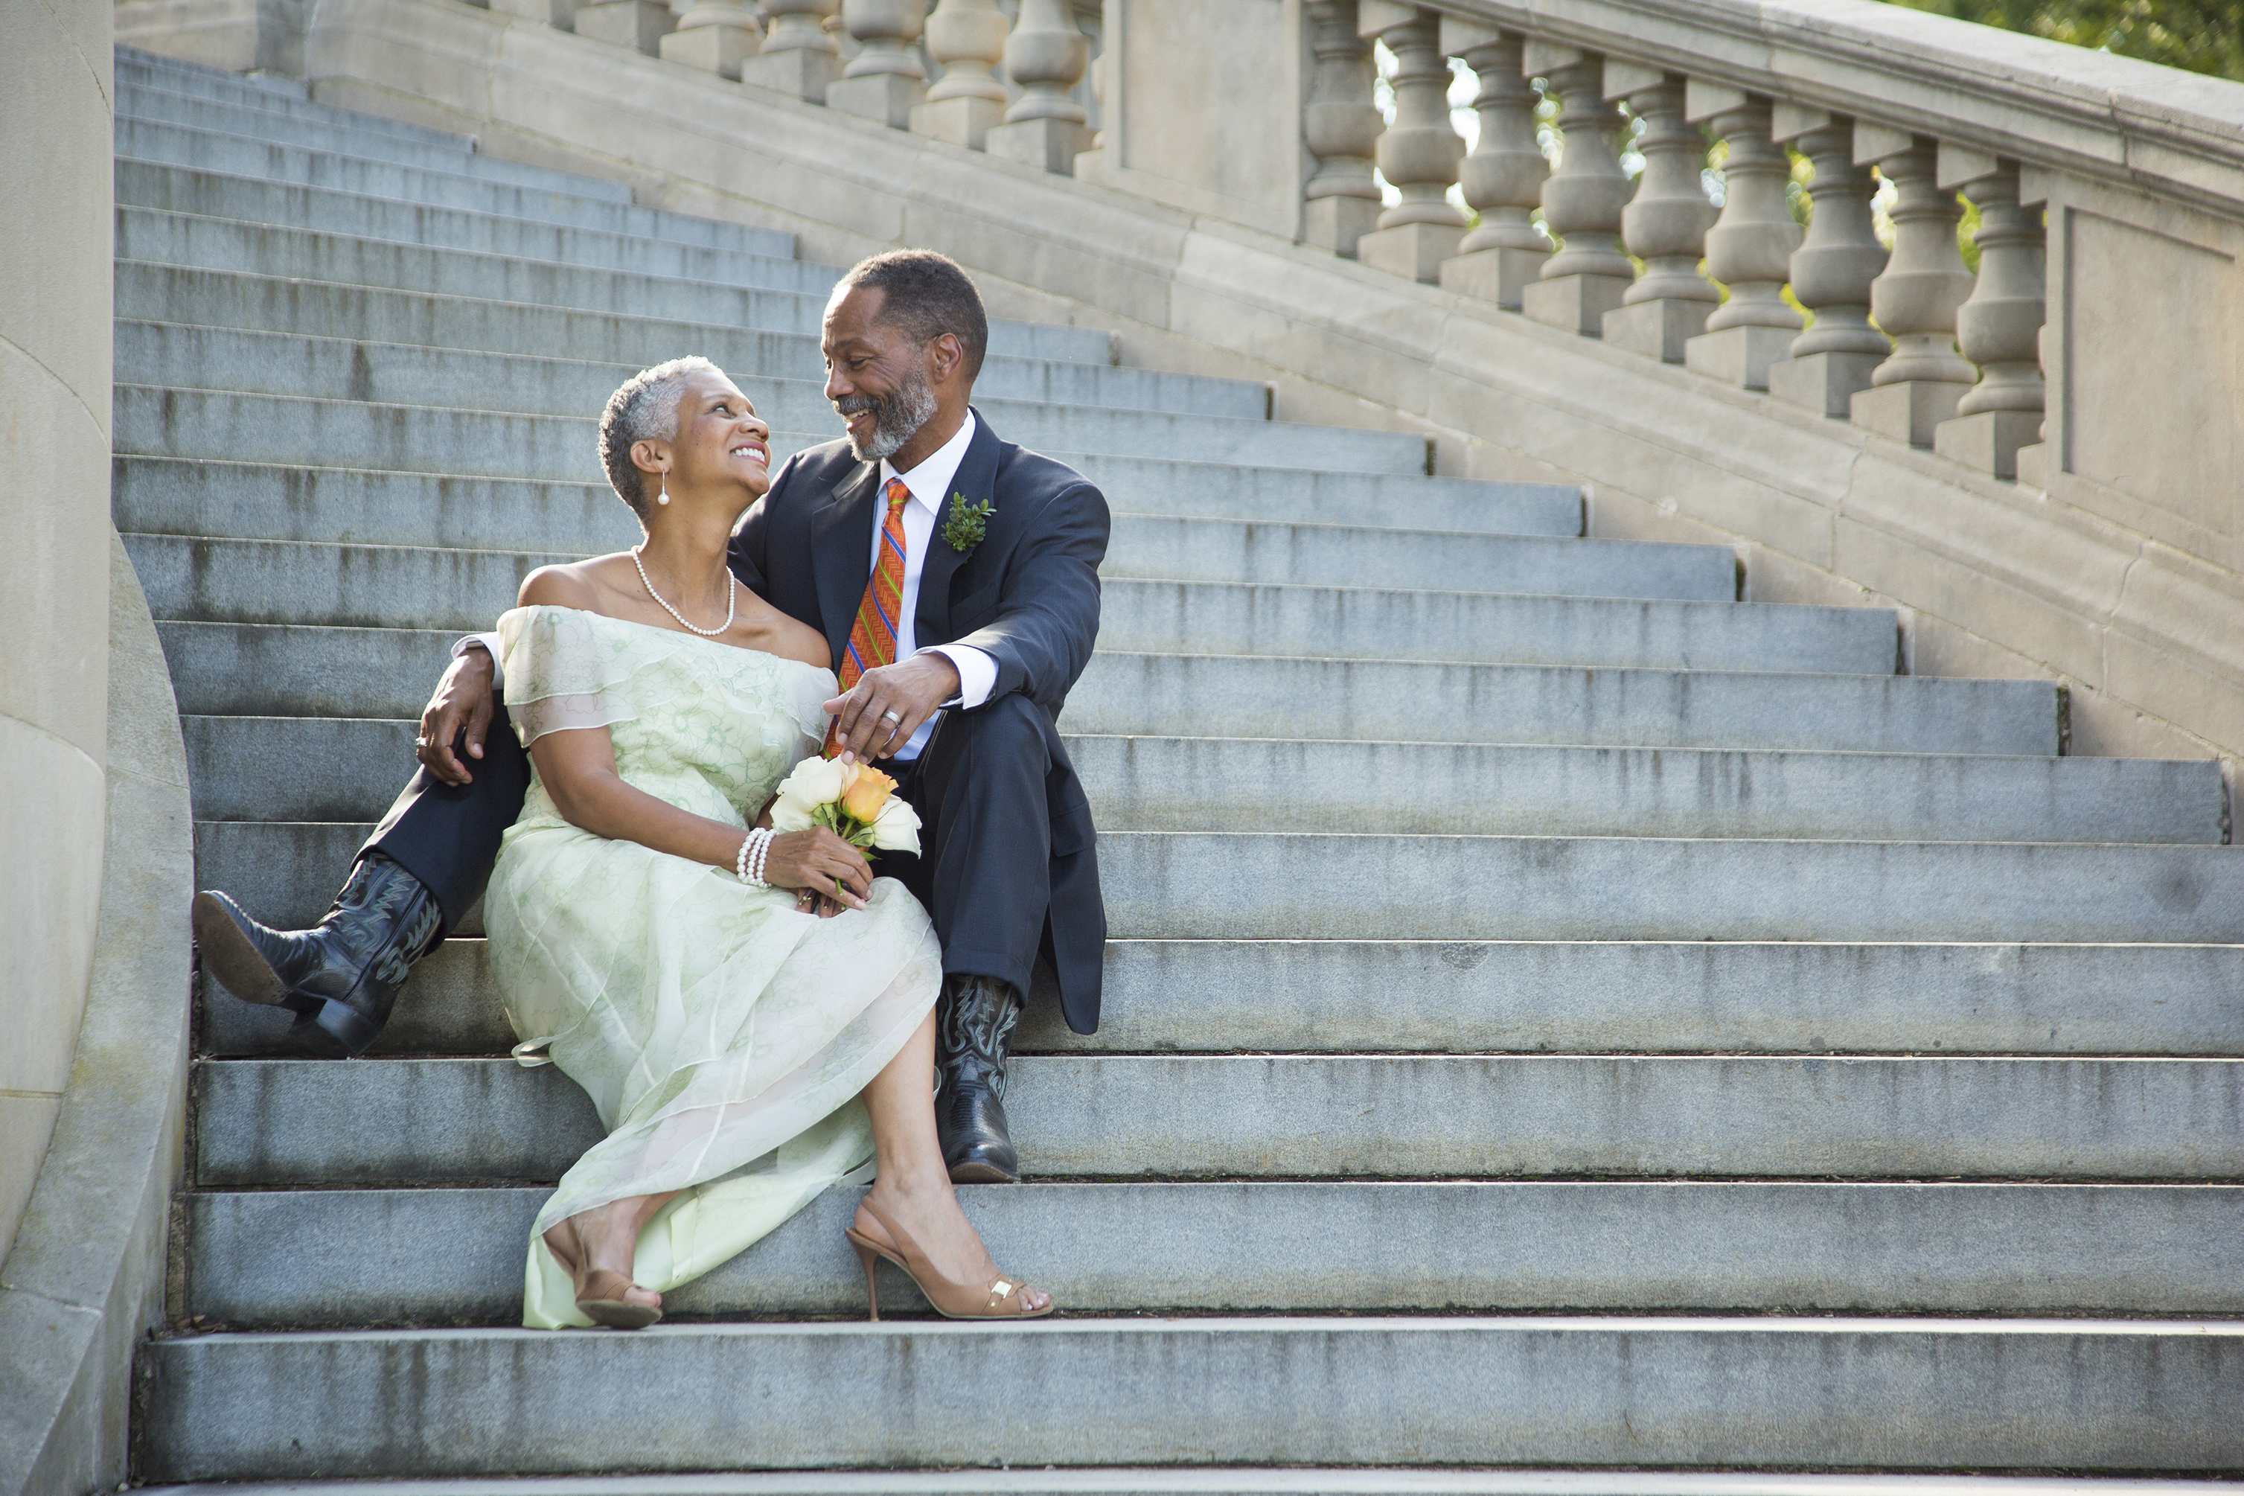
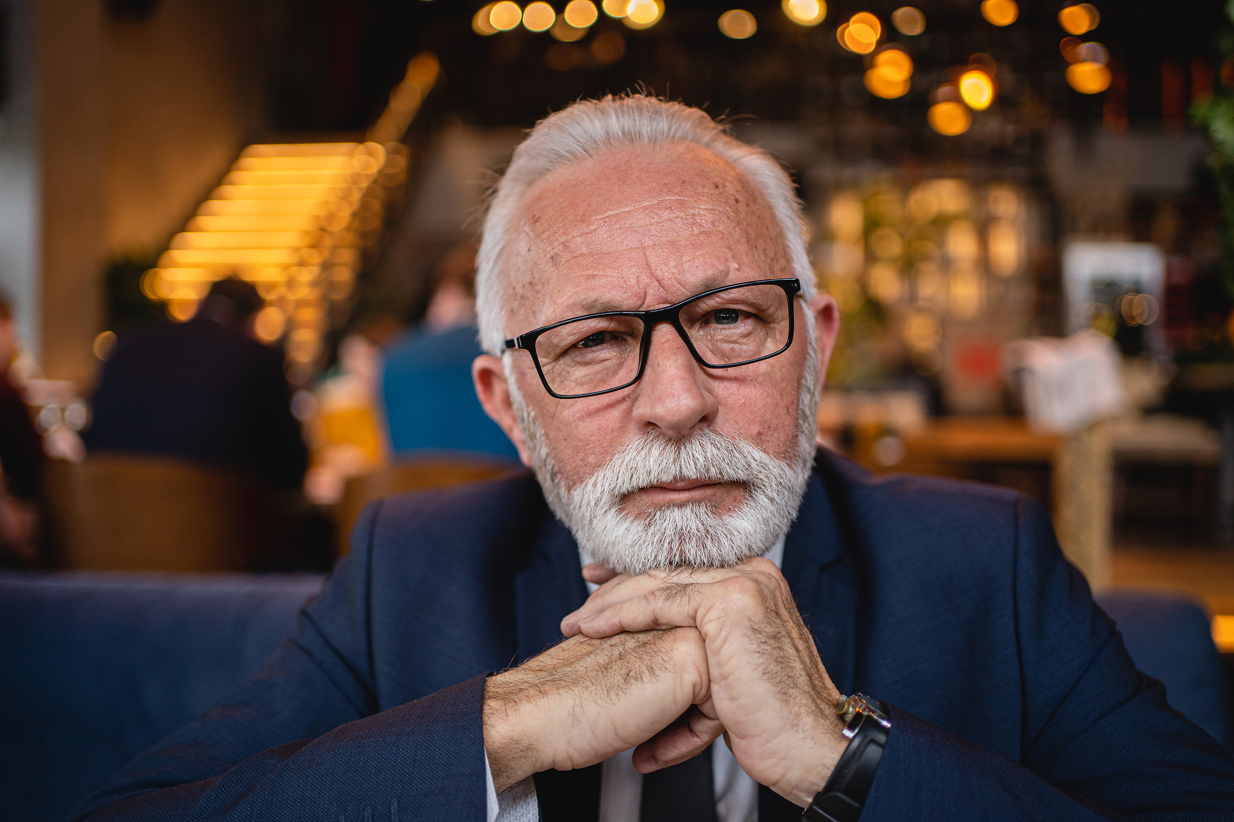
What is sexuality?
Sexuality is a fundamental need, and it includes a variety of activities:
sexual stimulation or expression
kisses, looks and touches, cuddles and hugs, caresses and massages
thoughts and fantasies
proximity and physical closeness
It can also encompass a multitude of sensual and erotic activities, without being sexual in nature.

Slide 6
Body changes
Woman
Loss of libido with menopause
Vaginal dryness
Pain during intercourse
Man
Loss of libido with andropause
Erectile difficulties
Irritation during intercourse
Notes:
Other situations that have an impact on seniors’ sexuality
Living in a private residence for seniors
Become a caregiver
Other diseases
Diabetes
High pressure
Heart Diseases
Cancer
Alzheimer, le parkinson, etc.

Slide 7
Ways to help with those changes
  Hormones
  Natural Product
  Lubrifiant

Slide 8
The look we have on the body
What changes as we age is the way we look at an attractive body image.
We've often associated our self-confidence with our ability to attract with our bodies. And getting older is a test of this ability, since aging is associated with the loss of youth and the death of sexual desire.
And we forget that a person's true appeal comes when we're with them and they make us want to move, talk and laugh, and when they exude energy, joie de vivre or sexual desire.
Notes:
In your opinion, is a person who is young and appears to be lifeless, joyless and sedentary attractive?
Often, the comment I get when people see me is that I look younger in person than I do in photos. And according to these people, this is due to the energy I exude, my joie de vivre, my welcome approach and my smile.

Slide 9
Transforming that look on the aging body
To transform this look, we need to take a step towards acknowledging our value as a person by :
Acknowledging the experience of aging
Looking at who we are as a person by recognizing ourselves as bearers of something unique, good and valuable
Stepping out of the external gaze and expectations
Recognizing our own needs and desires
Accepting this new reality to feel free to be who we are
Notes:
Alors, comment transformer ce regard ? Est-ce facile ? Non, c’est un travail à chaque changement majeur que nous vivons dans notre corps

Slide 10
Acceptance
Acceptance is a key step, because resistance to these changes can lead to depression.
  Growing old a trial of the body
  It means taming the changes in our bodies that we don't like
  I t means mourning the loss of the version of ourselves we used to love, that body that we loved
  Aging has both physical and psychological consequences
    It creates a gap between the image we have of ourselves and our new reflection in the mirror
Notes:
Pour accepter, cela demande de reconnaître que :
Vieillir
L’étape de l’acceptation est celle la plus difficile à transverser car cela demande de faire le deuil de cette version de nous que nous aimions.

Slide 11
Other ways to keep the feeling of being attractive
Taking care of your physical and mental health:
  A healthy diet
  Exercise, including toning up
  Laughing, having fun
  Develop intimate, relational and sexual communication
  Ask yourself the following questions:
      How can I feel attractive?
      How can I be attractive?
Notes:
Alors, comment transformer ce regard ? Est-ce facile ? Non, c’est un travail à chaque changement majeur que nous vivons dans notre corps

Slide 12


Communication andSexuality
Cette photo par Auteur inconnu est soumise à la licence CC BY
Cette photo par Auteur inconnu est soumise à la licence CC BY-NC

Slide 13
Communication and Sexuality
One of the keys to a successful relationship is emotional and relational communication. Adding this intimate communication in the sexuality is an additional element to have a greater satisfied sex life.
Sexual communication means being able to express your sensuality, i.e., expressing your emotions, your needs, your likes and dislikes, your fantasies and desires, and taking action to meet them.
This requires the participation of both partners to transform sexuality, i.e., to move from masculine to feminine sexuality.
Notes:
Plus jeune, souvent la sexualité est davantage dans la sexualité masculine et en vieillissant, cela demande d’aller vers la sexualité féminine où la sensualité prend davantage
Le dessus.
Pour nourrir sa sexualité à deux, cela demande d’entretenir une communication, oser parler de ce que nous aimons
Émotions – peur que tu ne me trouves plus belle, désirable
Besoins: j’ai besoin que tu me caresses davantage avant d’aller plus loin
désirs

Slide 14
Five languages of love by Gary Chapman
Words of appreciation
Say words of appreciation for what your partner does or is.
Quality time
Having special moments for listening and sharing, being present.
Receiving Gifts
Offer gifts to let your partner know how important he or she is to you.
Acts of Service
Show your love with concrete actions to demonstrate your attachment.
Physical touch
Kissing, hugging and holding hands are ways of communicating love, without forgetting relationships.

Slide 15
Conclusion
A successful sex life as we age means stepping out of our comfort zone to find the sexual satisfaction we need to feed our emotional needs.
And that means changing the way we are looking at our bodies and our ability to attract; and accepting to move away from male sexuality towards female sexuality.

Slide 16

QUESTIONS
Cette photo par Auteur inconnu est soumise à la licence CC BY-SA

Slide 17
Références
Mais tu ne m’avais pas dit cela !, Vidal-Graf, Carolle et Serge, Jouvence Édition, 2013
La sexualité ne prend pas sa retraite !, Landry, Sébastien, Editions in Press, 2019
Le crépuscule du désir ? Comprendre la sexualité des adultes vieillissants, Doucet, Patrick, Les Éditions du Trécarré, 2022
La sexualité des personnes âgées, Manoukian, Alexandre, Éditions Lamarre, 2011

Slide 18
References – Website
La vie sexuelle des personnes âgées | Le Devoir
«Les personnes âgées ne sont pas asexuelles ou post-sexuelles!» (ulaval.ca)
Une intervention sexologique auprès des hommes âgés : la gestion des buts personnels par le récit de vie (uqam.ca)

Slide 19

THANK YOU
Lorraine Séguin
819-213-1473
lorraineseguin.tra.coach@gmail.com
Site web: Accueil - Thérapies Coaching Animation Conférences Gatineau Lorraine Seguin (therapeute-coach-lorraine-seguin.com)

